Slide 1
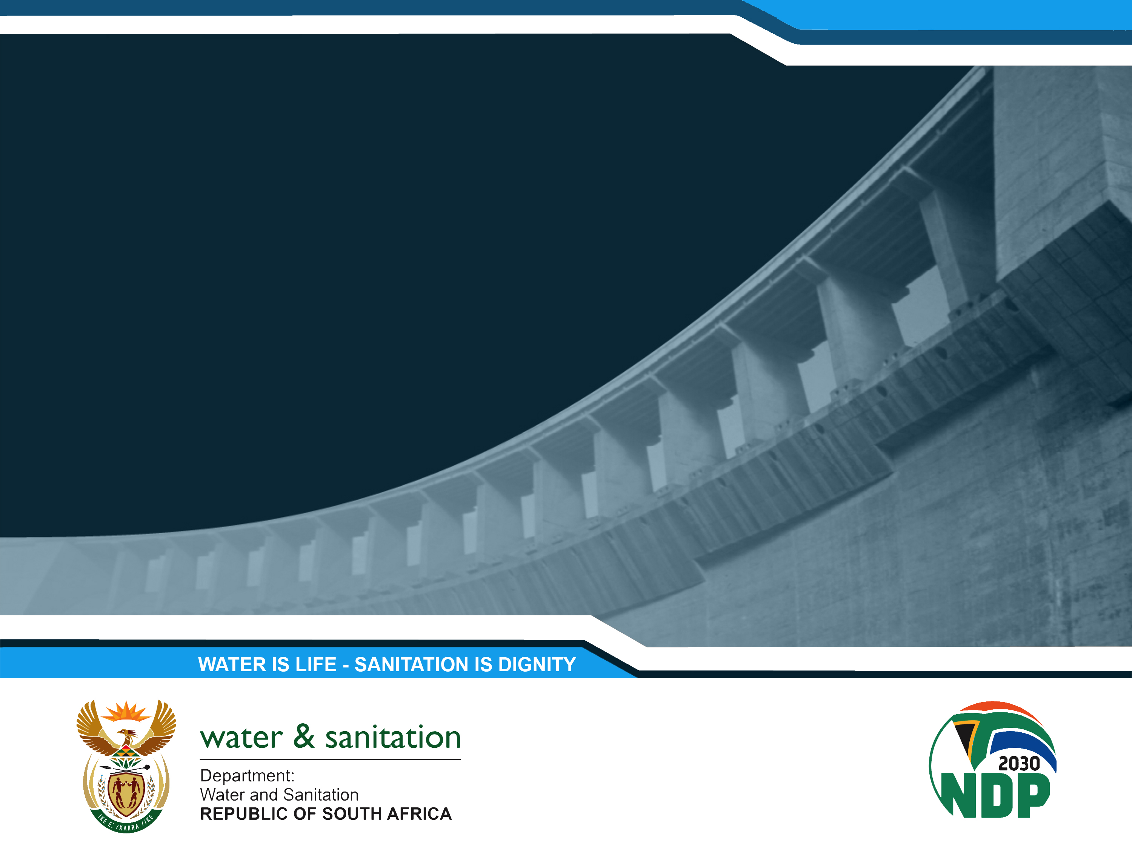
INVESTIGATION OF GROUNDWATER AND SURFACE WATER INTERACTION FOR THE PROTECTION OF WATER RESOURCES IN THE LOWER VAAL CATCHMENT (WP11380)
PRESENTATION TITLE
Presented by: Name Surname
Designation: Director
Directorate: Communication Services
Date: 15 April 2019
Presentation PSC 3
Presented by: K. Sami
Designation: Associate
Directorate: WSMLeshika Consulting
Date: September 27 2023

Slide 2
Lower Vaal Surface- groundwater interactions
PRESENTATION OUTLINE
Study Objectives
Summary of Groundwater Quality Report
Summary of Protection Zones Report
Summary of Interaction Report
Outline of Main Report and findings
Outstanding Items

Slide 3
Lower Vaal Surface- groundwater interactions
PROJECT OBJECTIVES
Review existing water resource information
Conduct a hydrocensus on an institutional level
Conduct a groundwater resource assessment of recharge, baseflow, abstraction, groundwater balance
Quantify aquifer parameters and describe aquifer types
Determine groundwater-surface water interactions both in terms of quality and quantity to determine protection zones
Capacity building and skills transfer to DWS staff
24 Month project duration
RED = covered in this reporting period

Slide 4
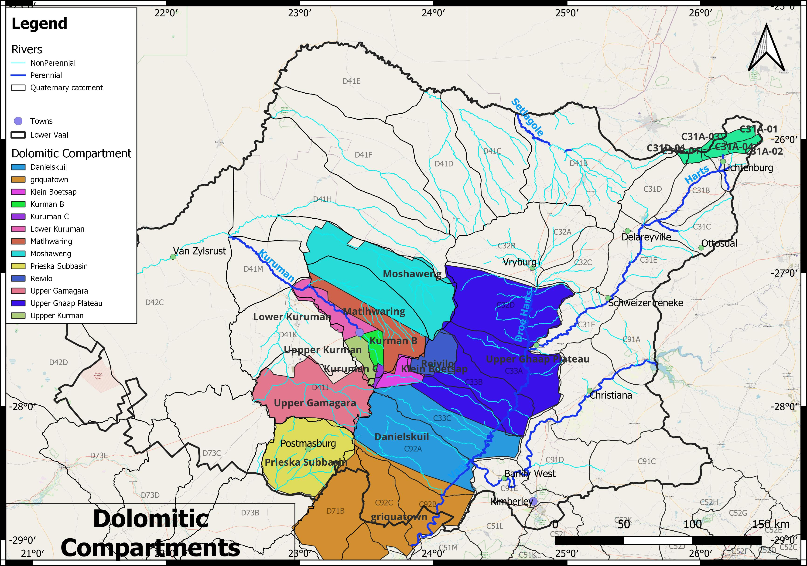
Lower Vaal Surface- groundwater interactions
STUDY AREA

Slide 5
Lower Vaal Surface- groundwater interactions
GROUNDWATER QUALITY REPORT
This report categorises groundwater quality in terms of macro and microconstituents by:
Quaternary catchment
Processes and Catchment characteristics that impact on groundwater quality

Slide 6
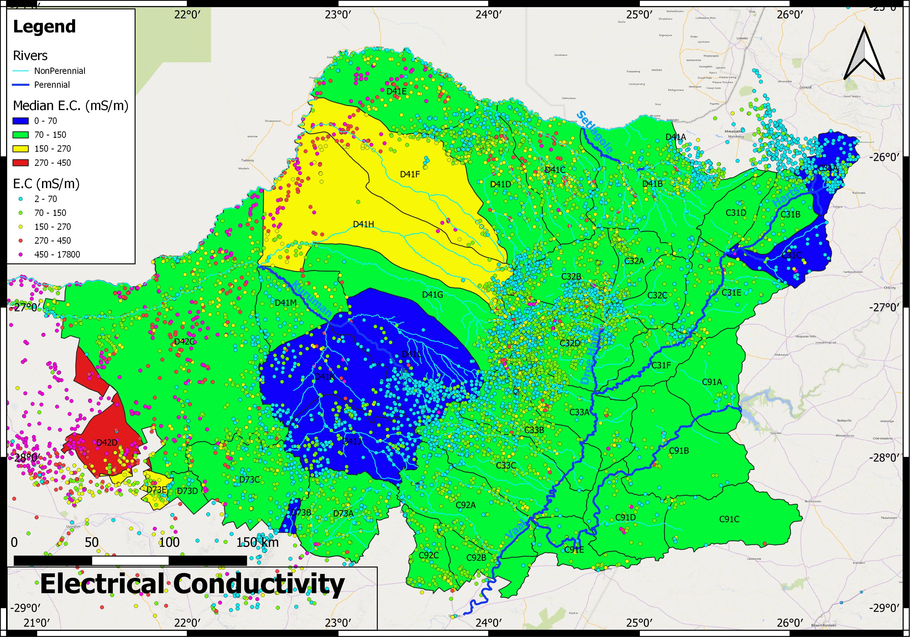
Lower Vaal Surface- groundwater interactions
MEDIAN EC
Quat | Average | Median | 20th percentile | 40th percentile | 60th percentile | 80th percentile | 100th percentile | Potable fraction
C31A | 60.96 | 60.15 | 35.86 | 57.1 | 62.9 | 75.1 | 291.2 | 98.72

Slide 7
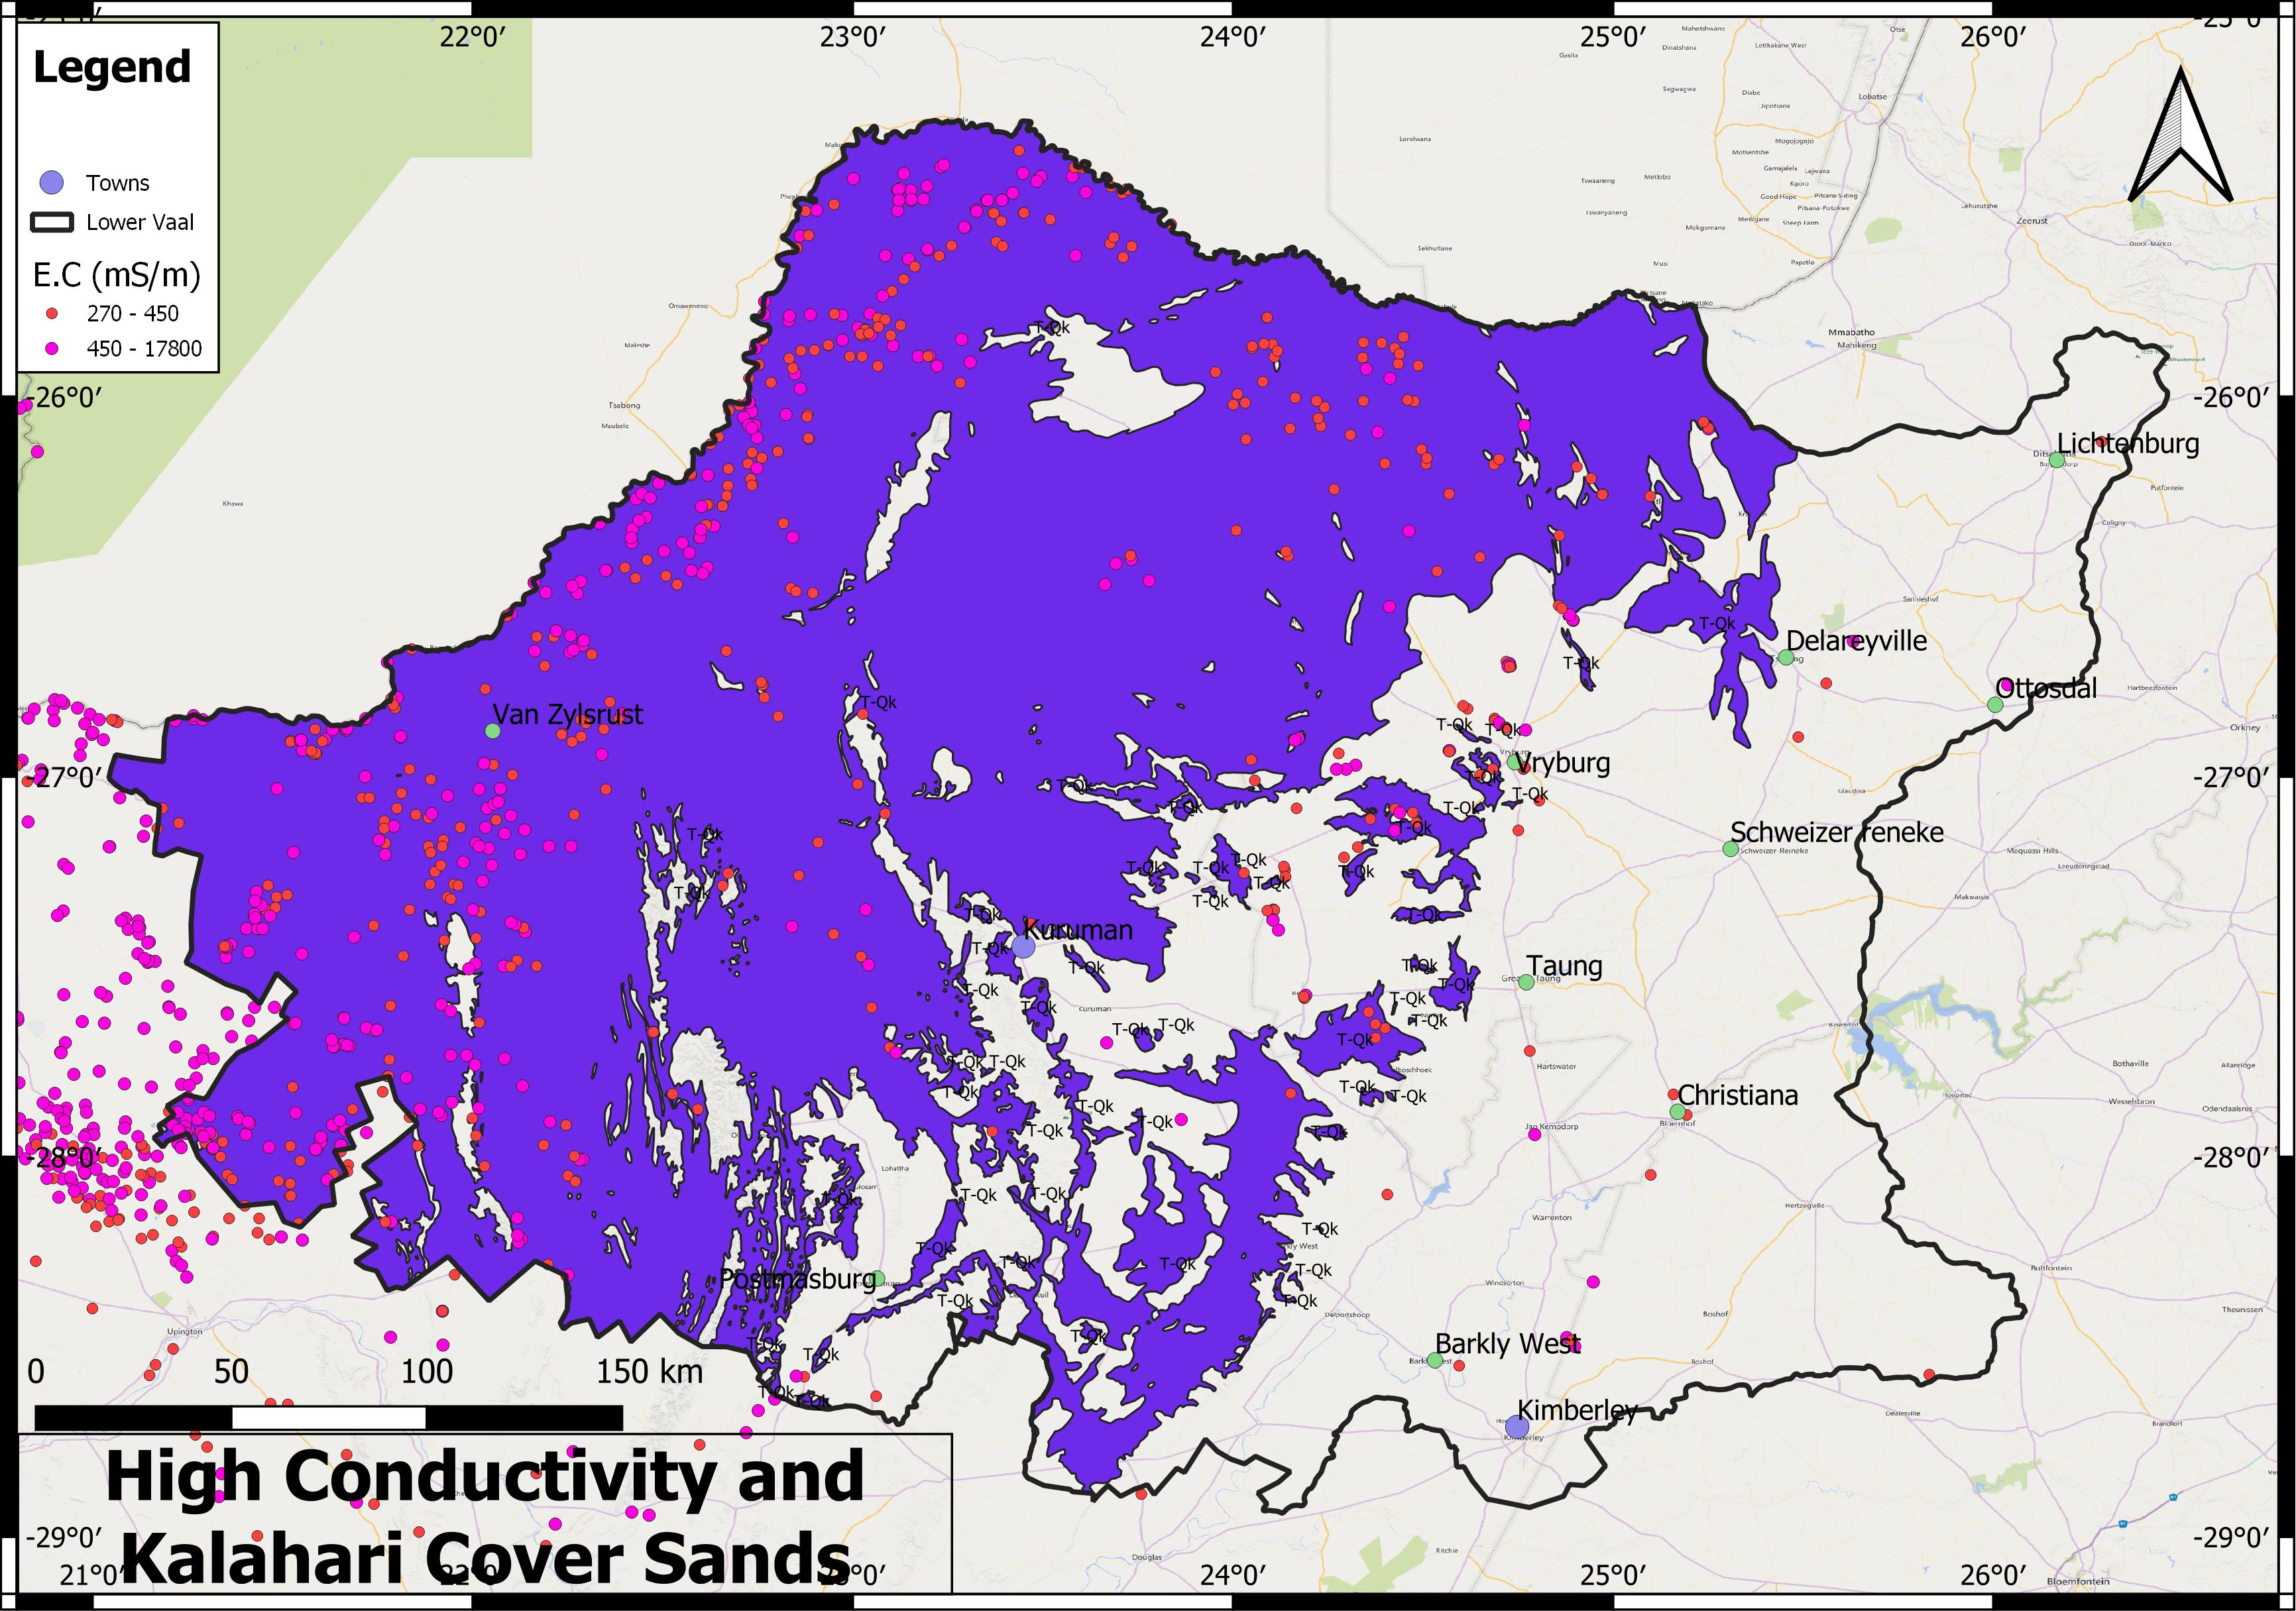
Lower Vaal Surface- groundwater interactions
HIGH EC and Kalahari cover

Slide 8
Lower Vaal Surface- groundwater interactions
EC
Class 0 to 1, with an EC of less than 150 mS/m, in the dolomitic aquifers
Only a few boreholes are of Class 2, indicative of very localised contamination.
Over most of the eastern portion of the study area groundwater is of Class 1-2
Groundwater of Class 2 and 3 is found at Hartswater where irrigation from the Vaalharts occurs in C33A-C, however, the median remains Class 1.
Groundwater of Class 3-4 occurs from Vryburg to Reivilo in C32B, D41G and C33B. These areas are associated with communities, irrigated lands, and extensive dryland farming.
Western region has highly variable water quality
The presence of large endoreic areas results in worsening groundwater quality to Class 3 and 4 since salts are not exported and accumulate in pans, creating variability in water quality.
Linear trends of Class 0-1 groundwater occur along the Kuruman and Molopo rivers, indicative of flood waters and discharge from dolomite springs recharging the aquifer along the rivers.
Boreholes with a high electrical conductivity of Class 3 and 4 are largely restricted to areas covered by Kalahari sands, which are dry, endoreic, and where the sand cover serves to reduce recharge

Slide 9
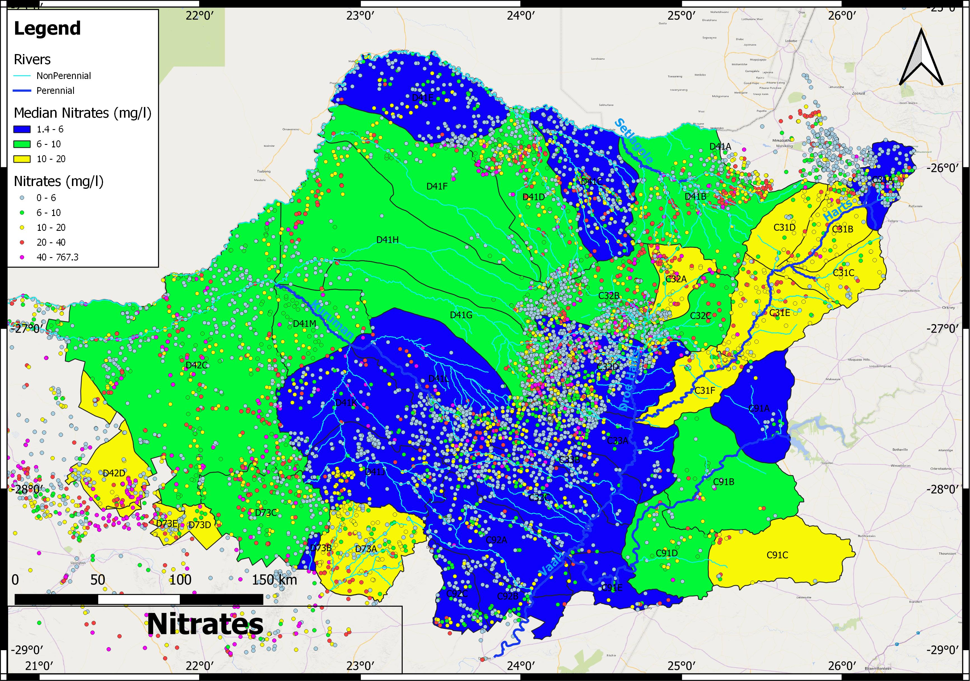
Lower Vaal Surface- groundwater interactions
NITRATES

Slide 10
Lower Vaal Surface- groundwater interactions
Management Class | Description
I | >95% Class 0 or 1
II | >95% Class 0-2
III | Class 3 or 4 or <75% Class 0-2
NITRATES
No significant nitrification is evident in the lower Vaalharts area of C33
Elevated nitrates occur in a band of dryland agriculture between Vryburg and Lichtenburg in C31and C32, and east of Kimberley and Christiana in C91C.
In the west, natural dryland nitrate conditions occur due to the absence of vegetation and organic material to uptake nitrates
In C31 and C91C, less than 50% of boreholes are potable due to nitrates
Potability also decreases westwards to under 50% in D42 and D73.
Many catchments are borderline but classified as Present Status Category (PSC III), with 80-95% of boreholes in Class 0-2
Quaternary | Class 0 | Class 1 | Class 2 | Class 3 | Class 4 | Classification | % Class 0-2
C31A | 142 | 33 | 34 | 22 | 3 | III | 89.32
C31B | 16 | 11 | 41 | 15 | 2 | III | 80.00
C31C | 13 | 5 | 17 | 4 | 0 | III | 89.74
C31D | 5 | 7 | 10 | 4 | 0 | III | 84.62
C31E | 22 | 9 | 42 | 20 | 1 | III | 77.66
C31F | 8 | 11 | 13 | 7 | 2 | III | 78.05
C32A | 41 | 19 | 52 | 44 | 12 | III | 66.67
C32B | 336 | 133 | 126 | 90 | 61 | III | 79.76

Slide 11
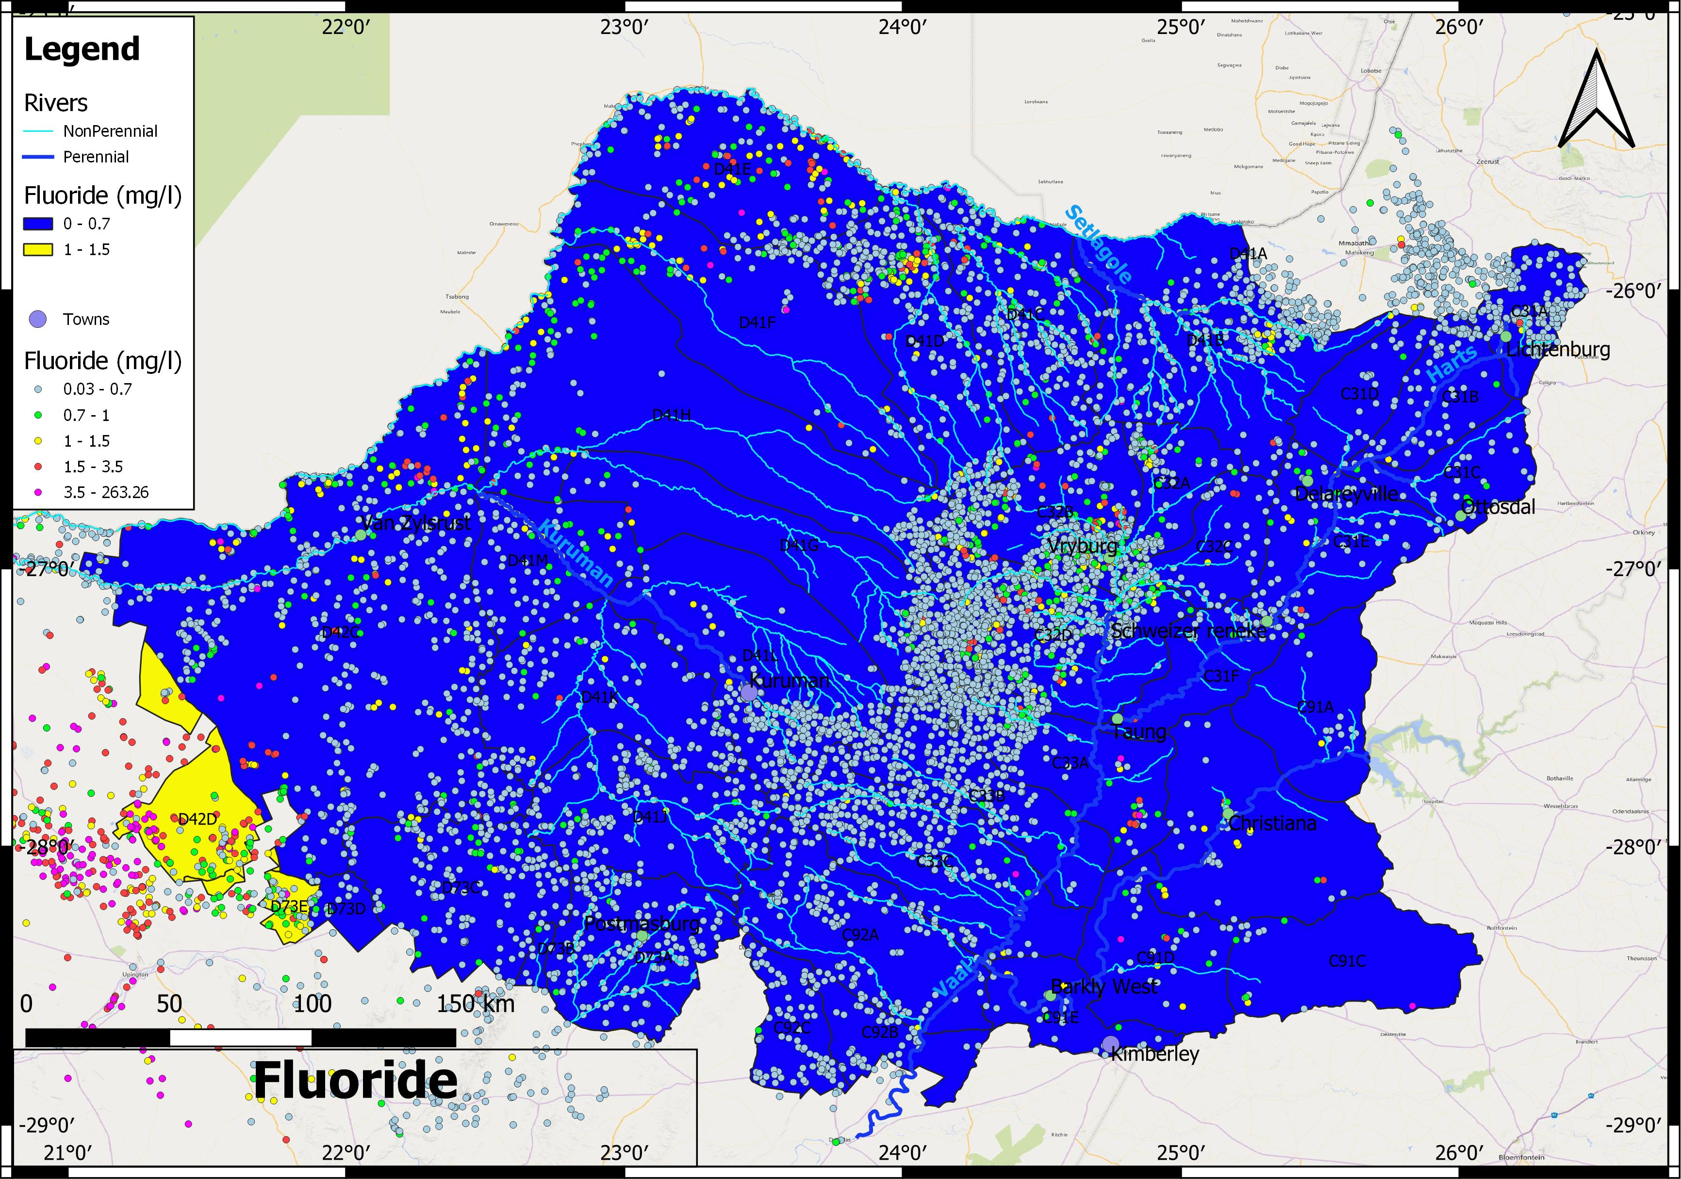
Lower Vaal Surface- groundwater interactions
FLUORIDE

Slide 12
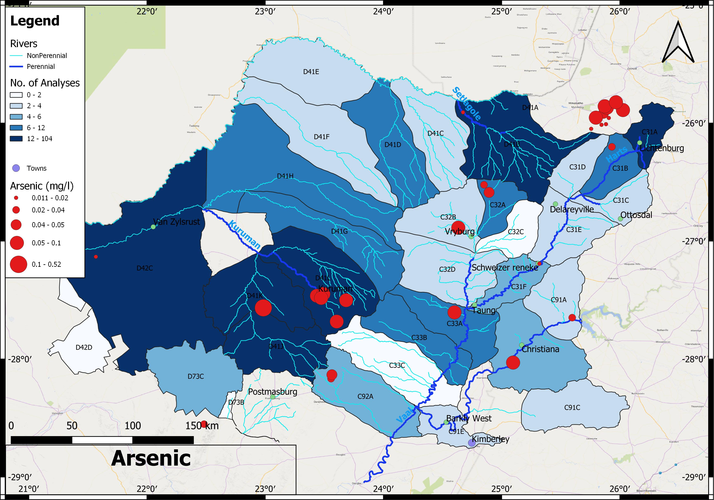
Lower Vaal Surface- groundwater interactions
METALS
Quat | As | B | Ba | Cd | Cr | Fe | Hg | Mn | Mo | Ni | Pb | Zn
C31A |  | 0.049 | 0.054 |  | 0.009 | 0.159 |  | 0.066 |  |  |  | 0.946
C31B | 0.023 | 0.107 | 0.266 |  | 0.009 | 0.022 |  | 0.01 | 0.007 |  |  | 1.082

Slide 13
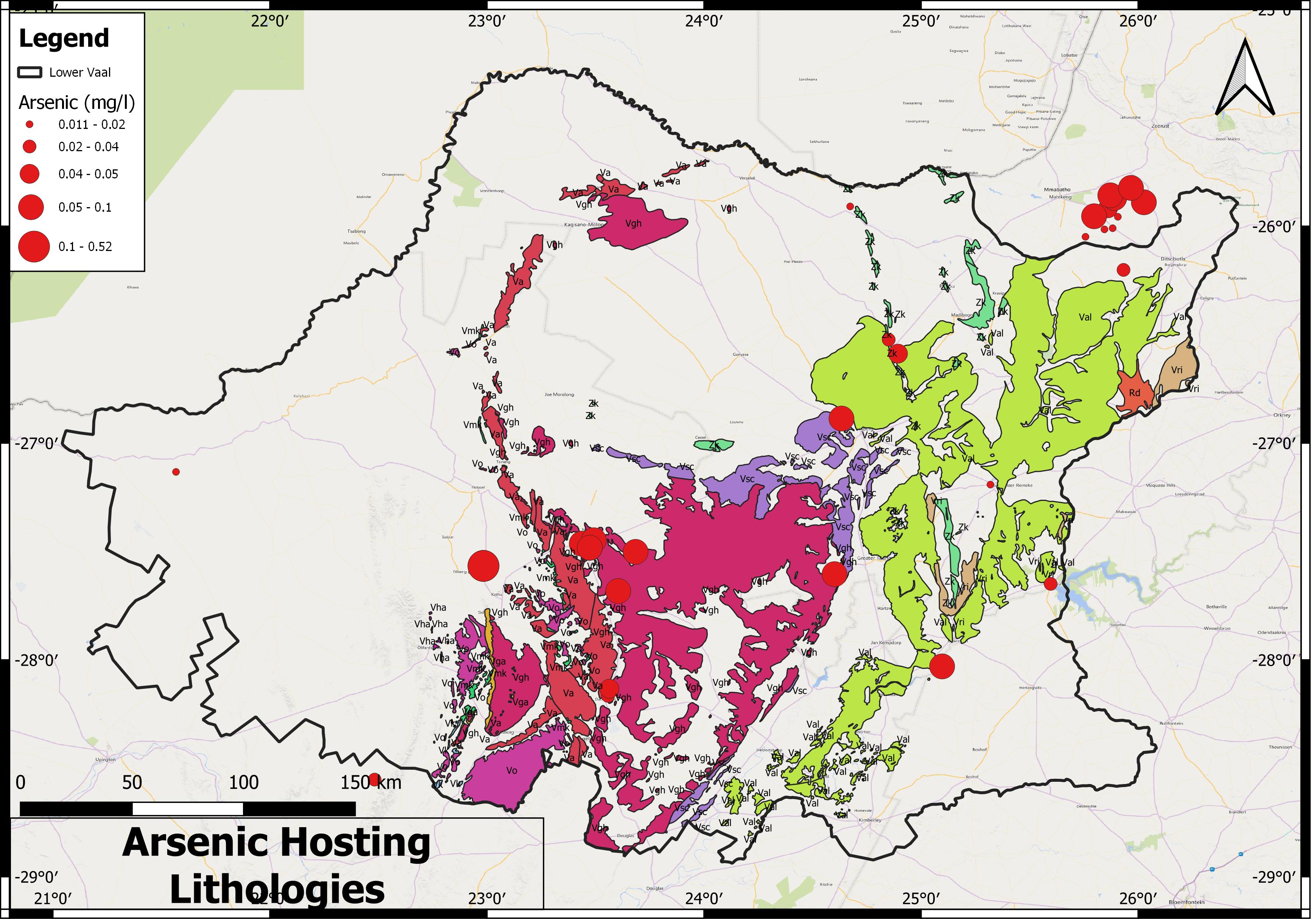
Lower Vaal Surface- groundwater interactions
METALS – Prediction to infill sparsity of data

Slide 14
Lower Vaal Surface- groundwater interactions
PROCESSES
High recharge resulting in the Ideal to Good water quality in the dolomites
Losses of streamflow to the aquifer ameliorating water quality by dilution in a linear pattern along the Kuruman and Molopo Rivers
Endoreic areas exhibiting poorer water quality due to the lack of surface runoff to export salts and their accumulation in pans, resulting in highly variable water quality
Localised contamination from irrigation, vegetation removal for dryland agriculture and possibly sanitation practices, resulting in nitrate enrichment
Isolated zones of mineralisation results in pockets of elevated metal concentrations, especially arsenic.
Groundwater can be categorised according to Present Status Category based on the worst PSC category in terms of EC, Nitrates and Fluoride Groundwater is generally of Category III. Many catchments are borderline classified as PSC III, with 80-95% of boreholes in Class 0-2 in terms of nitrates.
Management Class | Description
I | >95% Class 0 or 1
II | >95% Class 0-2
III | Class 3 or 4 or <75% Class 0-2

Slide 15
Questions and Clarification

Slide 16
Lower Vaal Surface- groundwater interactions
PROTECTION ZONES REPORT
Catchments which need to be protected have been delineated by:
Aquifer vulnerability
Baseflow indices, indicating the significance of baseflow which could be depleted by abstraction.
Declines in water level indicating existing over abstraction.
Stress Indices of catchments
Water supply boreholes which need to be protected have been delineated by:
A buffer zone based on capture zone around the borehole, which is determined from recharge and registered abstraction rate.

Slide 17
Lower Vaal Surface- groundwater interactions
PROTECTION ZONES METHODOLOGIES
GROUNDWATER QUALITY
Local water supply point capture zones – based on recharge and abstraction
Aquifer pollution vulnerability – DRASTIC
GROUNDWATER QUANTITY
Impact of abstraction on baseflow – baseflow index (fraction of recharge)
Stress index
Groundwater levels – stable, historic decline, gradual decline, declining trend

Slide 18
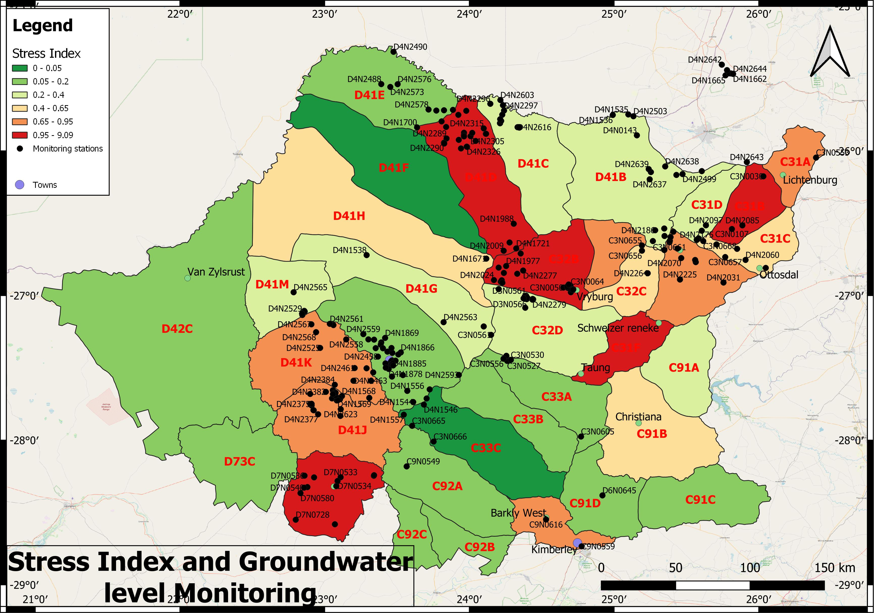
Lower Vaal Surface- groundwater interactions
STRESS INDEX AND AVAILABLE BOREHOLE DATA – where are the gaps in monitoring?

Slide 19
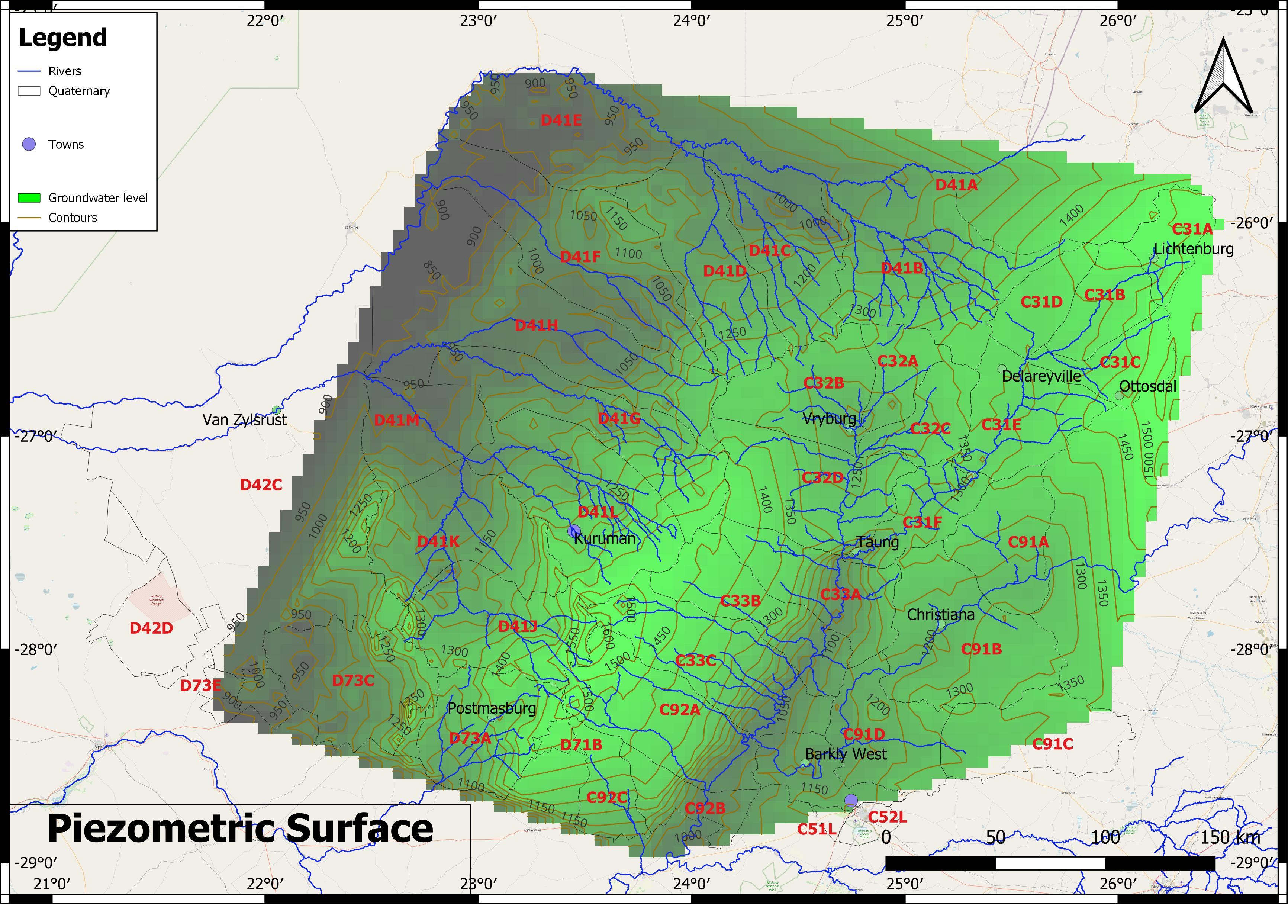
Lower Vaal Surface- groundwater interactions
PIEZOMETRIC MAP (>17000 BOREHOLES)

Slide 20
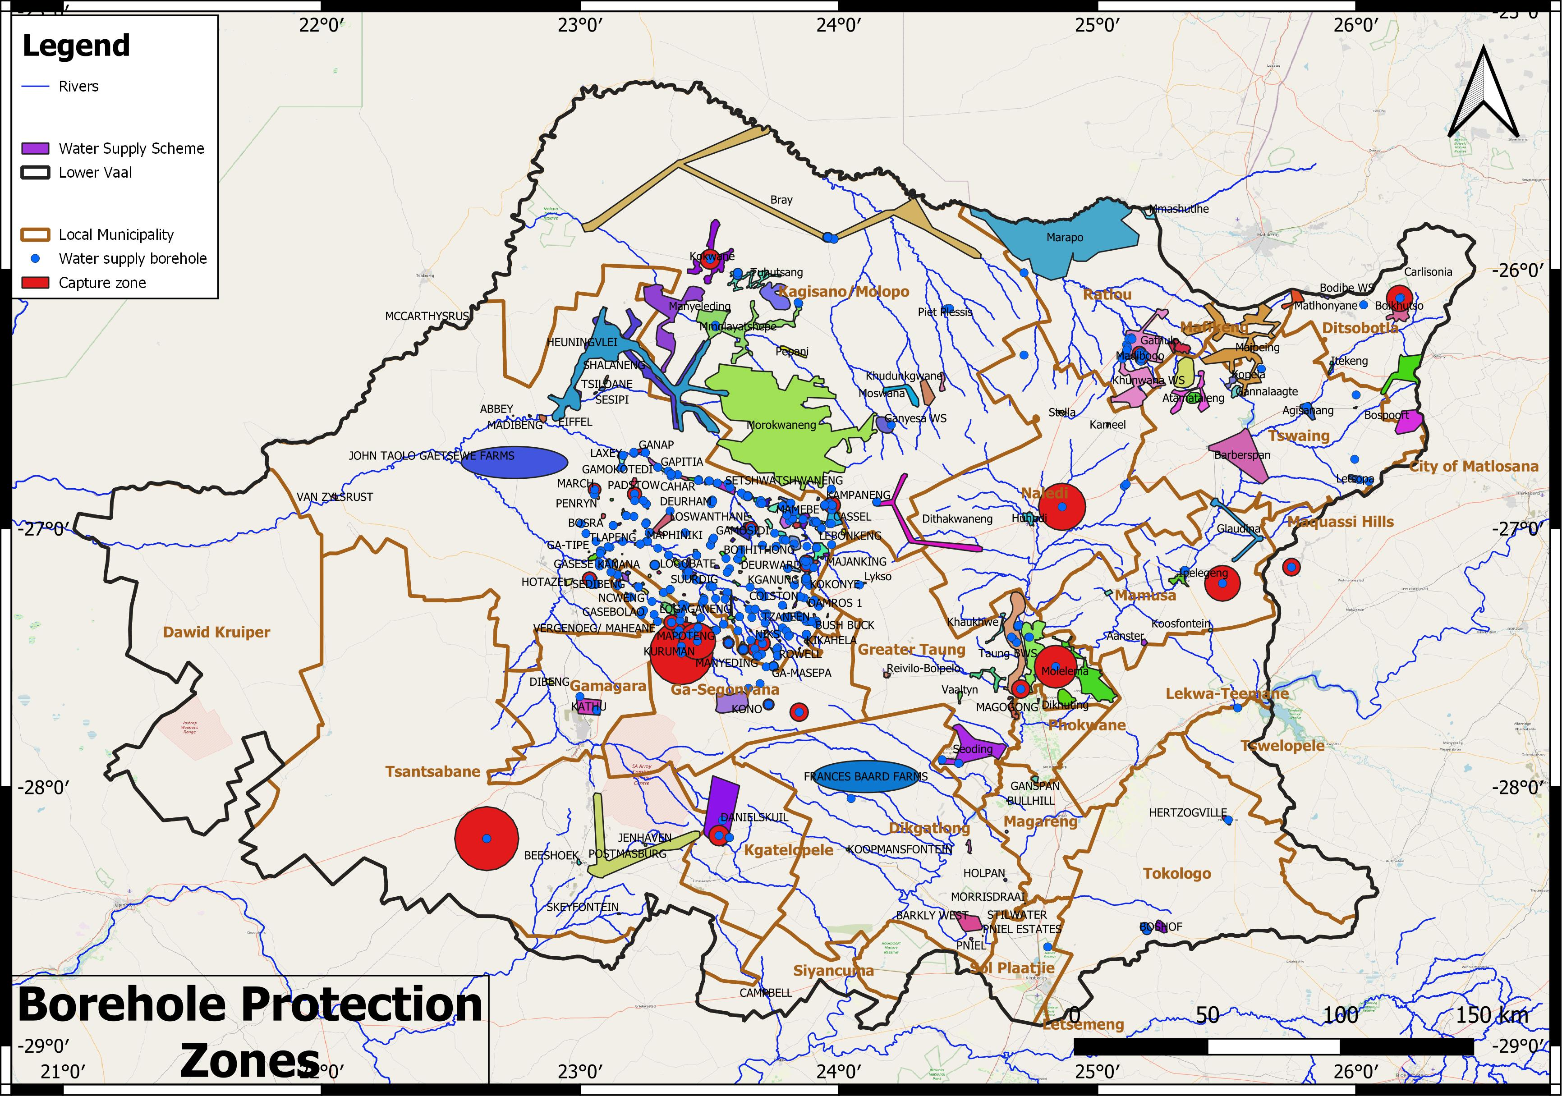
Lower Vaal Surface- groundwater interactions
BOREHOLE PROTECTION ZONES – control of land use

Slide 21
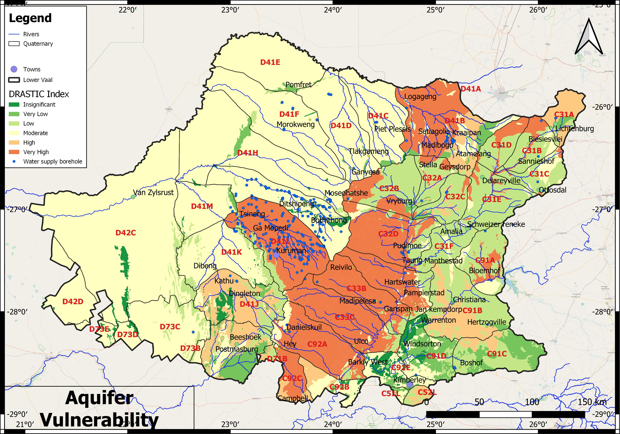
Lower Vaal Surface- groundwater interactions
AQUIFER VULNERABILITY – control of land use

Slide 22
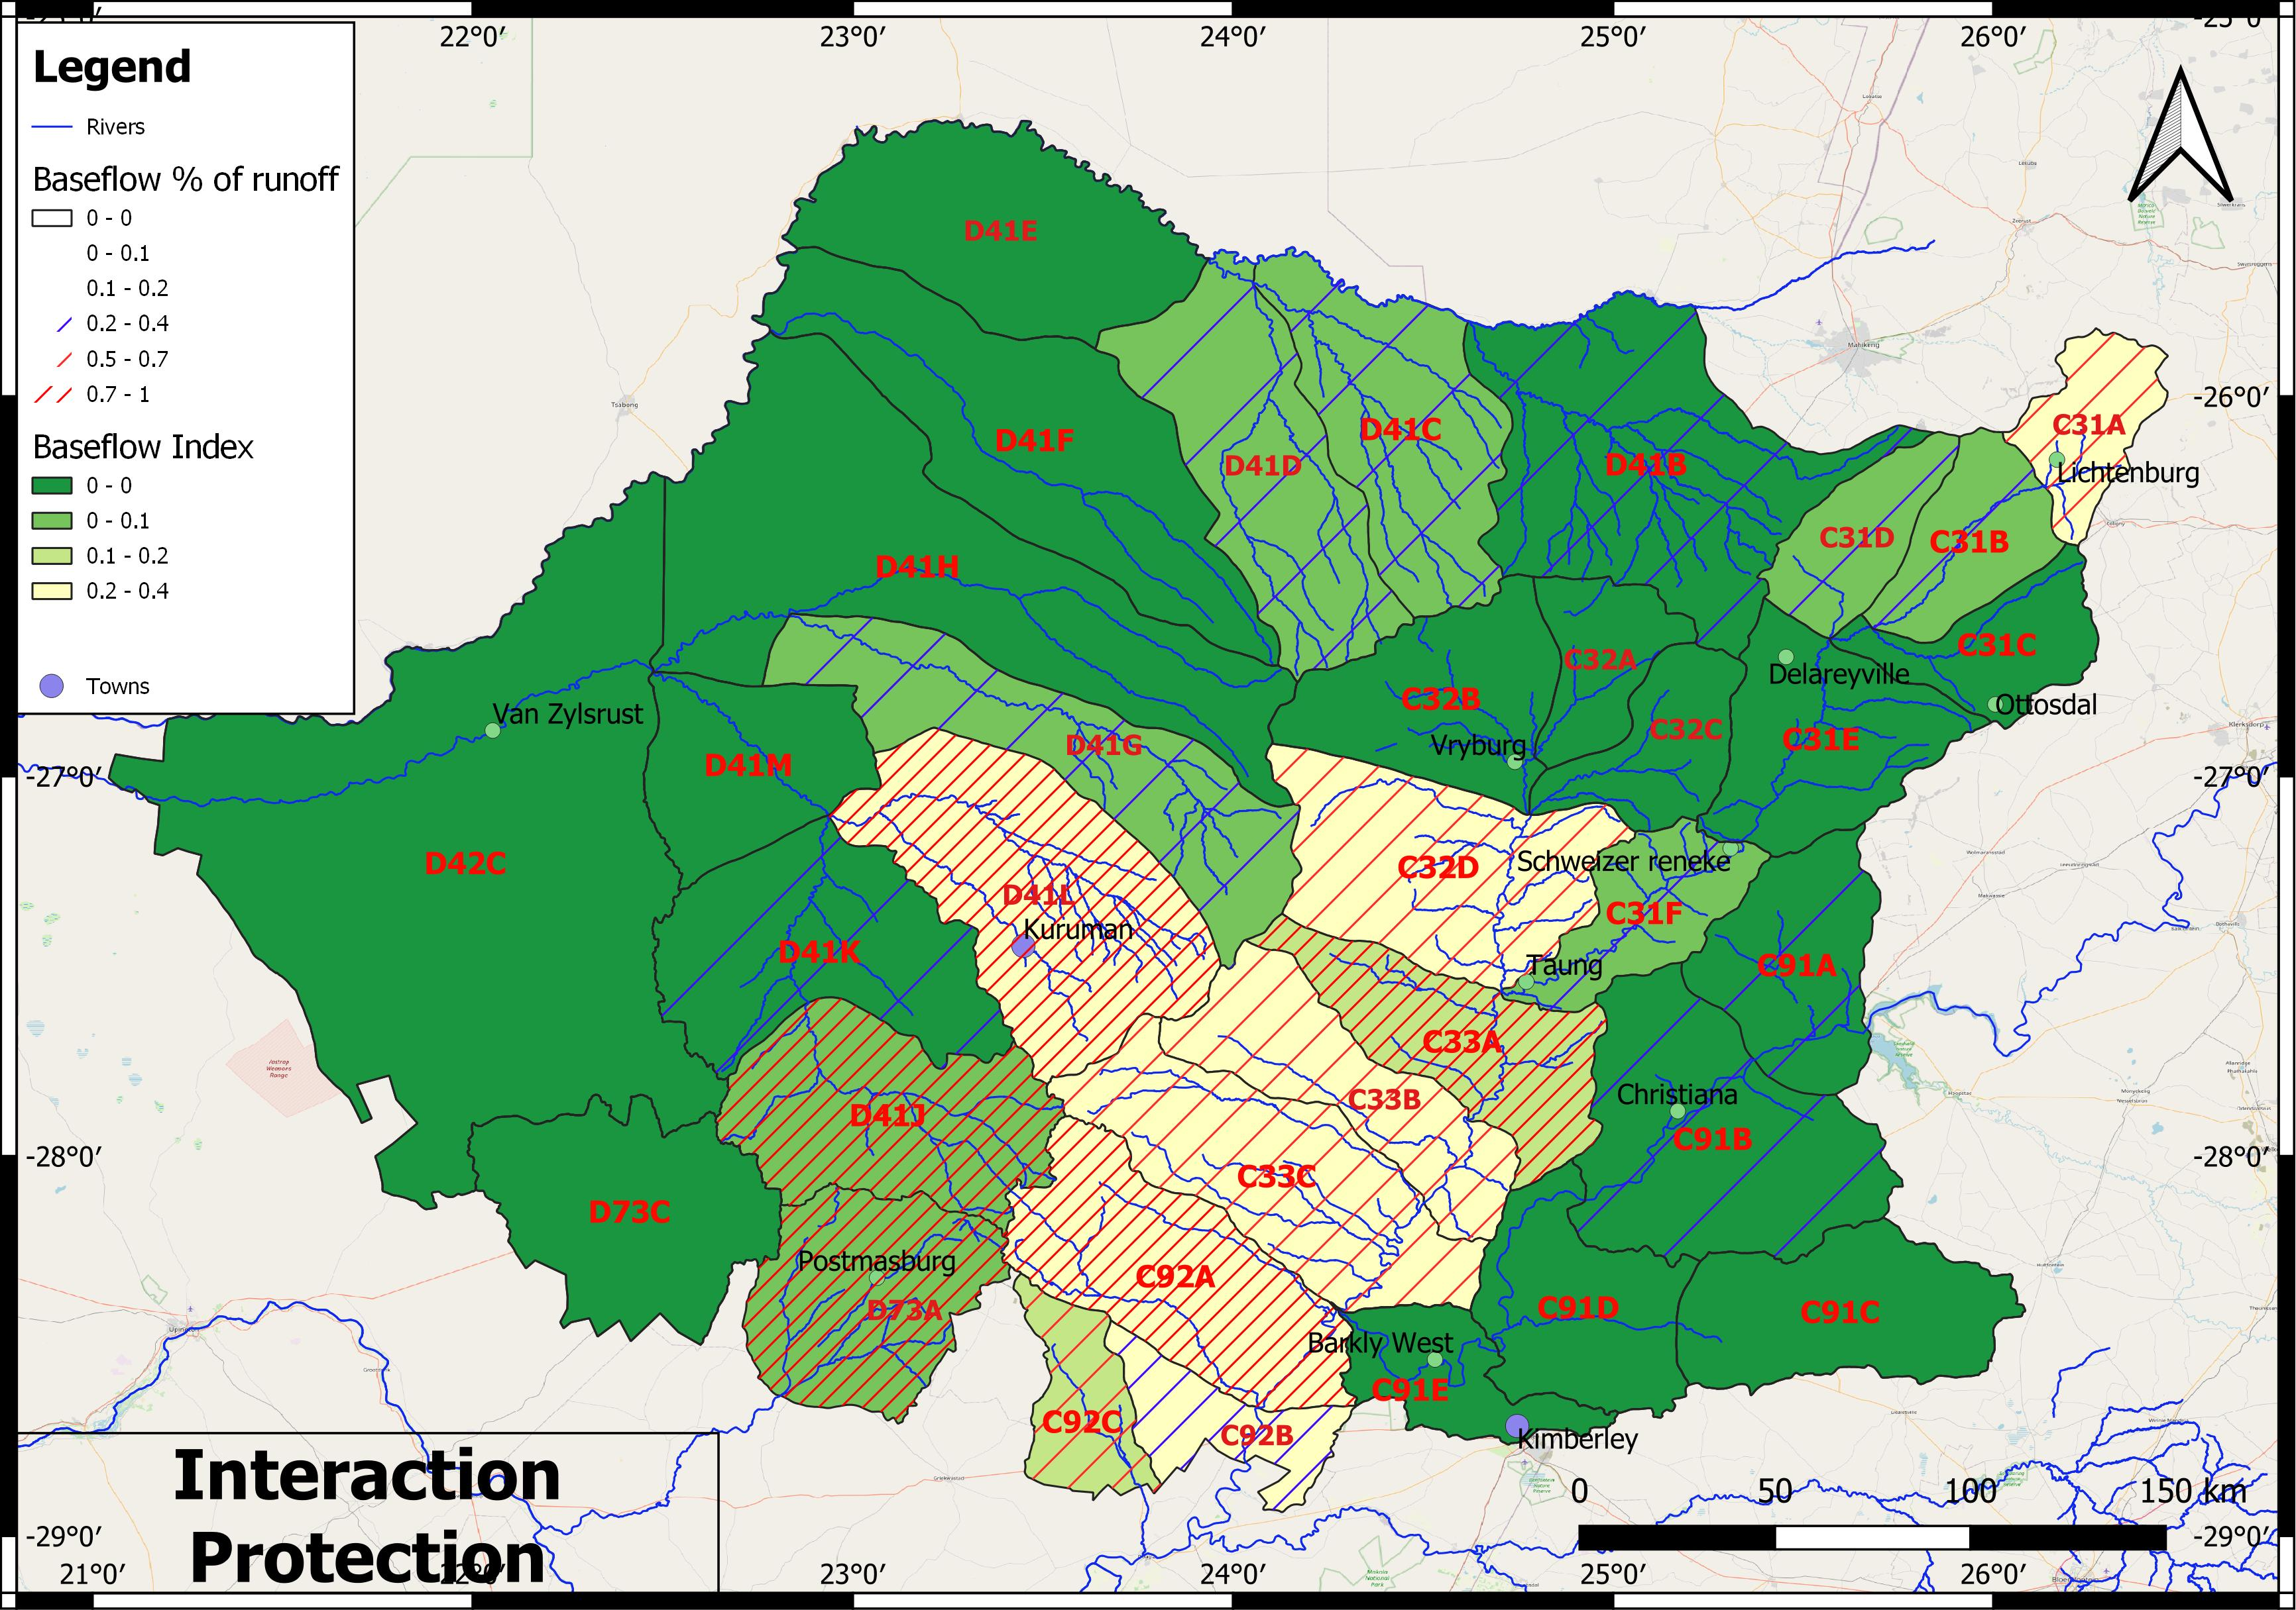
Lower Vaal Surface- groundwater interactions
BASEFLOW VULNERABILITY – where can abstraction affect surface water?
Baseflow/recharge

Slide 23
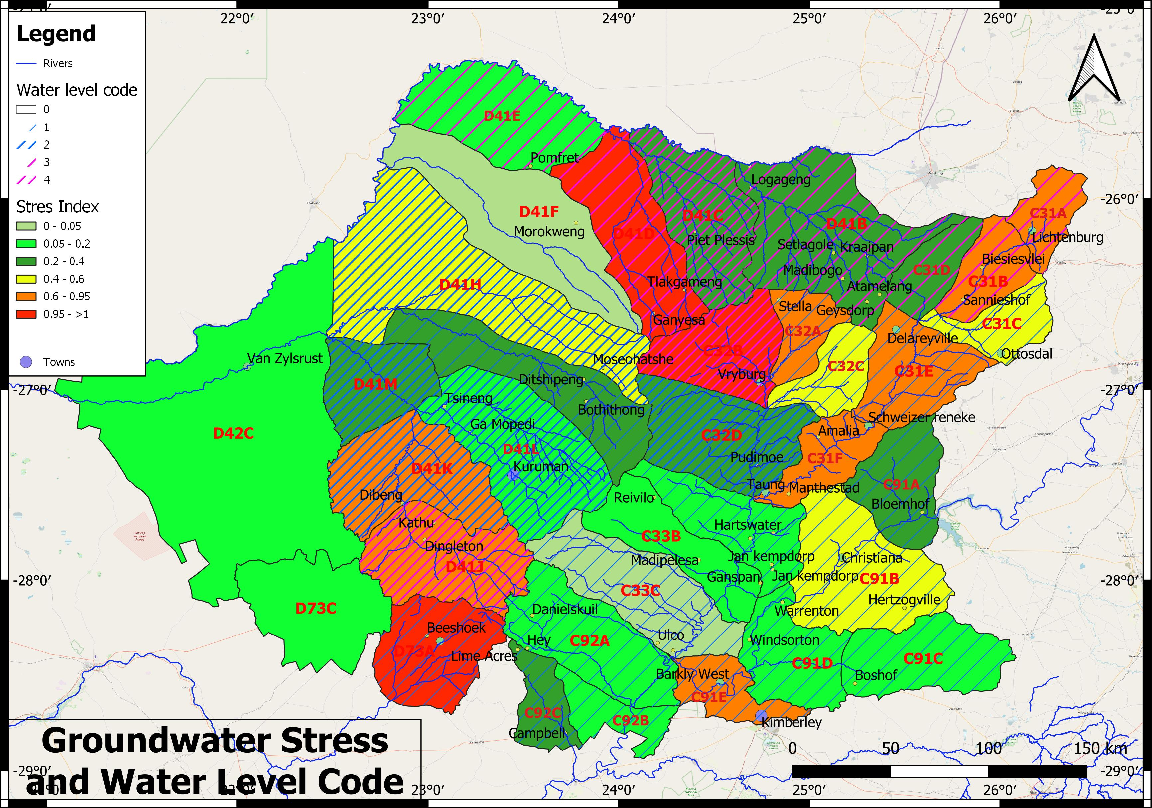
Lower Vaal Surface- groundwater interactions
GROUNDWATER STRESS AND WATER LEVEL – areas of groundwater stress
3= gradual decline
4= rapid decline

Slide 24
Questions and Clarification
Break

Slide 25
Lower Vaal Surface- groundwater interactions
INTERACTIONS REPORT
This report quantifies interactions by sub-Quaternary catchment and dolomitic compartment
Recharge
Natural State
Groundwater baseflow
Channel losses
MAR
Present Day
Channel losses
Baseflow reduction
MAR

Slide 26
Lower Vaal Surface- groundwater interactions
METHODS
WRSM Pitman modelling
Rainfall extended to 2021
Dolomitic compartments were made runoff units
Gross area utilised instead of nett area as in WR2012
Calibration against gauging stations and dam levels
‘Calibration’ against GRAII recharge
Inclusion of surface and groundwater abstractions and transfers
Inclusion of irrigation areas and dams
Quat | Average | Median | 20th percentile | 40th percentile | 60th percentile | 80th percentile | 100th percentile | Potable fraction
C31A | 60.96 | 60.15 | 35.86 | 57.1 | 62.9 | 75.1 | 291.2 | 98.72

Slide 27
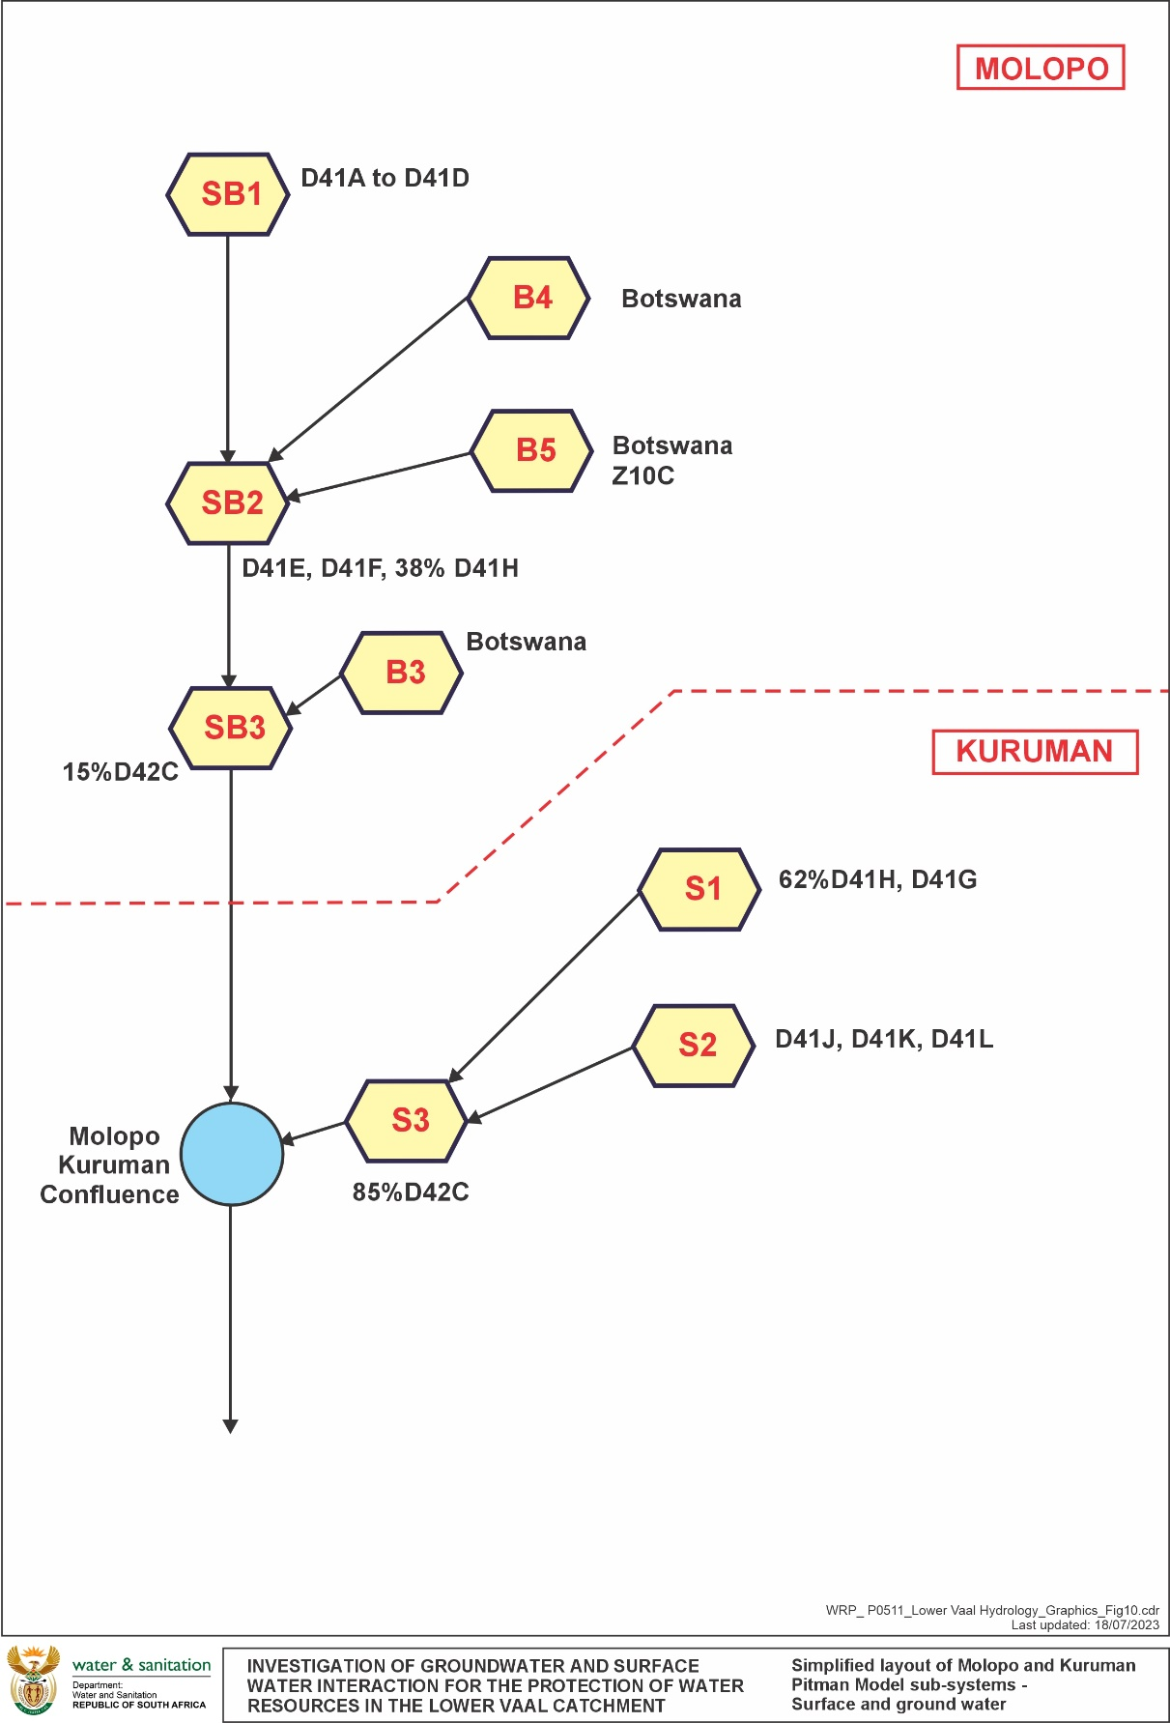
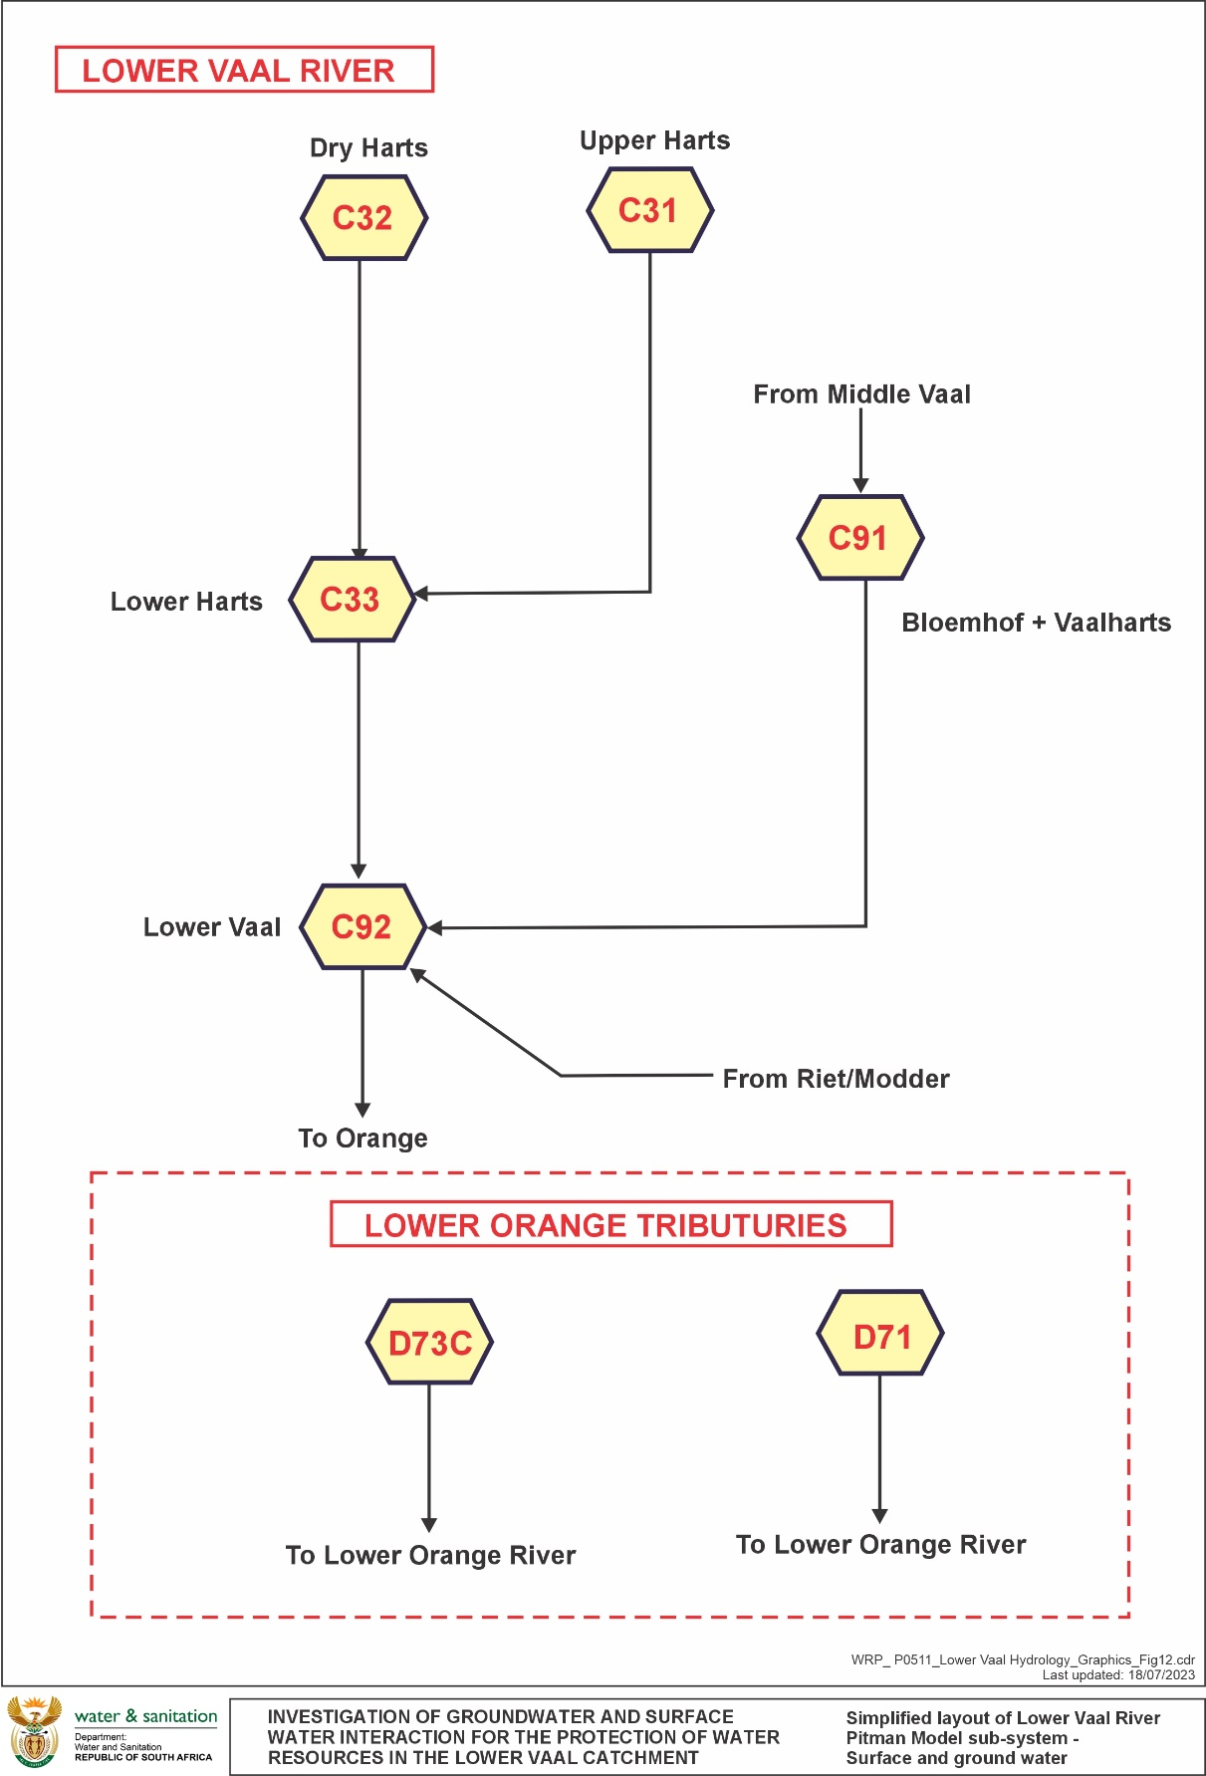
Lower Vaal Surface- groundwater interactions
Series of interconnected systems
NETWORKS

Slide 28
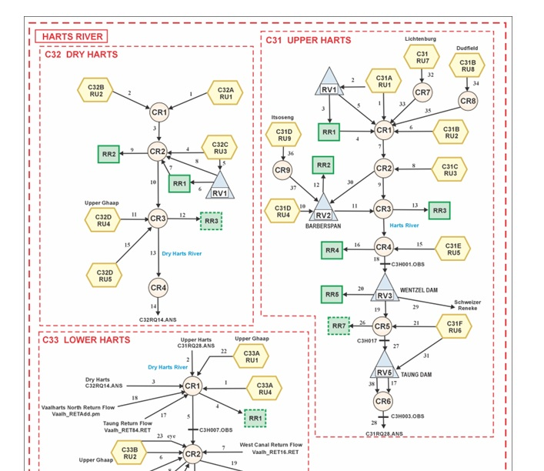
Lower Vaal Surface- groundwater interactions
NETWORKS – HARTS EXAMPLE
Dams, irrigation blocks, transfers, abstraction discharges

Slide 29
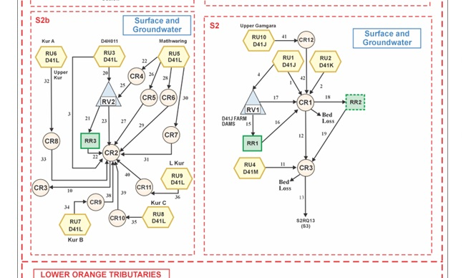
Lower Vaal Surface- groundwater interactions
NETWORKS – KURUMAN EXAMPLE

Slide 30
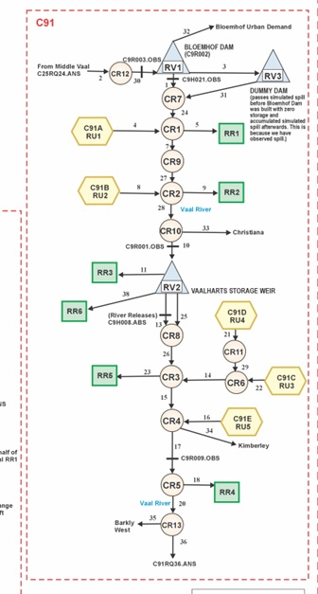
Lower Vaal Surface- groundwater interactions
NETWORKS – VAAL

Slide 31
Lower Vaal Surface- groundwater interactions
SIMULATIONS
Calibration: observed flow records, time series of surface and groundwater abstraction, irrigation area, the construction of reservoirs
Naturalisation: removing all anthropogenic effects to quantify the surface and groundwater resources and interactions
Present day hydrology: including present day anthropogenic effects from 1920-2021 to determine the impact of present-day water use on the runoff and interactions.

Slide 32
Lower Vaal Surface- groundwater interactions
RESULTS
Quaternary | Gross Area | Subarea area/ Nett area | MAP | MAR | GRAII Baseflow | Simulated Baseflow | Channel losses | GRAII Recharge | Simulated Recharge |  | Recharge (% of rainfall)
 | Km² | Km² | mm/a | Mm³/a | Mm³/a | Mm³/a | Mm³/a | mm/a | mm/a | Mm³/a
C31A | 1 402 | 649 | 577 | 5.39 | 0.95 | 0.02 |  | 24.89 24.89 | 9.55 | 6.20 | 1.66
C31A Lichtenburg |  | 753 | 577 | 9.32 |  | 9.32 |  |  | 34.14 | 25.70 | 5.92
C31B | 1 743 | 1 358 | 553 | 8.64 | 0.90 | 0.03 |  | 22.01 | 8.83 | 14.49 | 1.60
C31B Dudfield |  | 102 | 553 | 1.19 |  | 1.19 |  |  | 32.23 | 3.27 | 5.83
C31C | 1 635 | 1 635 | 566 | 11.85 | 0.95 | 0.17 |  | 21.59 | 8.83 | 14.44 | 1.56
C31D | 1 494 | 780 | 530 | 3.83 | 0.56 | 0.01 |  | 21.91 | 8.12 | 11.36 | 1.53
C31D Itsoseng |  | 96 | 530 | 1.02 |  | 1.02 |  |  | 30.43 | 2.91 | 5.74
C31E | 2 960 | 1 941 | 506 | 11.93 | 0.79 | 0.07 |  | 17.13 | 7.18 | 21.25 | 1.42
C31F | 1 789 | 1 789 | 477 | 7.05 | 0.35 | 0.32 |  | 12.59 | 6.10 | 10.91 | 1.28
C32A | 1 405 | 681 | 449 | 7.00 | 0.53 | 0.00 |  | 12.35 | 6.09 | 8.56 | 1.36
C32B | 3 002 | 1 587 | 434 | 13.64 | 1.26 | 0.05 |  | 13.62 | 6.09 | 18.28 | 1.40
C32C | 1 658 | 916 | 460 | 10.26 | 0.87 | 0.02 |  | 13.74 | 6.36 | 10.54 | 1.38
C32D Upper Ghaap | 4 140 | 2 943 | 442 | 22.75 | 1.84 | 22.75 |  | 17.10 | 18.16 | 53.44 | 4.11
C32D |  | 1 197 | 442 | 10.52 |  | 0.20 |  |  | 5.92 | 7.09 | 1.34
C33A Upper Ghaap | 2 859 | 1 317 | 432 | 4.34 | 1.36 | 4.34 |  | 14.01 | 14.38 | 18.94 | 3.33
C33A |  | 1 542 | 432 | 21.12 |  | 1.85 | 12.30 |  | 6.28 | 9.68 | 1.45

Slide 33
Lower Vaal Surface- groundwater interactions
NATURAL RECHARGE AND BASEFLOW
 | Area (km²) | MAR (Mm³/a) | WR2012 MAR (Mm³/a) | Baseflow (Mm³/a) | Recharge (Mm³/a) | Channel Losses
Harts
C31 | 9102 | 60.22 | 57.90 | 12.15 | 110.53 | 0.00
C32 | 7324 | 64.17 | 35.43 | 23.02 | 97.91 | 0.00
C33 | 9843 | 69.27 | 29.93 | 30.87 | 97.34 | 53.11
Total | 26269 | 193.66 | 123.26 | 66.04 | 305.79 | 53.11
Vaal
C91 | 14566 | 26.72 | 26.37 | 0.14 | 135.37 | 96.40
C92 | 7544 | 32.81 | 16.17 | 19.88 | 63.97 | 0.00
Total | 22110 | 59.53 | 42.54 | 20.02 | 199.34 | 96.40
Upstream inflow from Bloemhof dam |  | 1964.81
Molopo
D41 Molopo | 9525 | 24.83 | 17.86 | 0.22 | 92.06 | 40.13
D42 Molopo | 190 | 0.10 | 2.22 | 0.00 | 1.98 | 1.46
Upstream inflow from D41A |  | 14.27
Inflow from Botswana |  | 5.64
Kuruman
D41 Kuruman | 16841 | 31.63 | 101.83 | 22.45 | 178.60 | 31.16
D42 Kuruman | 1075 | 0.97 | 3.23 | 0.00 | 14.93 | 0.00
Total Molopo and Kuruman | 27631 | 57.53 | 125.14 | 22.67 | 287.58 | 74.74
D73 | 4418 | 0.61 | 0.00 | 0.33 | 12.38 | 0.31
Lower Vaal Grand Total | 80428 | 311.33 | 290.94 | 109.06 | 805.09 | 223.57
Grand Total |  | 2281.78 |  |  |  | 223.57

Slide 34
Lower Vaal Surface- groundwater interactions
PRESENT DAY RECHARGE AND BASEFLOW
 | Area (km²) | Incremental MAR (Mm³/a) | Baseflow (Mm³/a) | Groundwater Use (Mm³/a) | Channel Losses
Harts
C31 | 9102 | 26.86 | 10.39 | 73.94 | 0.96
C32 | 7324 | 58.08 | 22.08 | 66.85 | 0
C33 | 9843 | 140.05 | 30.49 | 7.40 | 26.4
Vaal
Upstream inflow from Bloemhof dam |  | 1964.81
C91 | 14566 | 1513.30 | 0.01 | 30.84 | 58.8
C92 | 7544 | 1794.04 | 19.2 | 10.84 | 32.04
Inflow from Riet River |  | 181.93
Transfer from Orange |  | 17.32
Molopo
D41A |  | 14.27
Botswana |  | 5.64
D41 Molopo | 9525 | 4.7 | 0 | 31.51 | 32.61
D42 Molopo | 190 | 2.91 | 0 | 0.42 | 1.92
Kuruman
D41 Kuruman | 16841 | 0.42 | 14.64 | 68.55 | 20.32
D42 Kuruman | 1075 | 0.21 | 0 | 2.34 | 1.18
D73 | 4418 | 0.35 | 0.28 | 48.13 | 0.31

Slide 35
Lower Vaal Surface- groundwater interactions
FLOW REDUCTION
Catchment | Natural |  |  | Present day
 | Incremental MAR (Mm³/a) | Baseflow (Mm³/a) | Channel Losses (Mm³/a) | Incremental MAR (Mm³/a) | Baseflow (Mm³/a) | Channel Losses (Mm³/a) | Groundwater Use (Mm³/a)
Harts | 140.55 | 66.04 | 53.11 | 140.05 | 62.96 | 27.36 | 148.19
Vaal | 2068.49 | 20.02 | 96.4 | 1794.04 | 19.21 | 90.84 | 41.69
Kuruman | 0.44 | 22.45 | 32.16 | 0.21 | 14.64 | 21.5 | 70.89
Molopo | 3.25 | 0.22 | 41.59 | 2.91 | 0 | 34.53 | 31.93
D73 | 0.61 | 0.33 | 0.31 | 0.35 | 0.28 | 0.31 | 48.13
Total | 2072.8 | 109.1 | 223.6 | 1797.51 | 97.1 | 174.54 | 340.8
Flow Reduction
 |  |  |  | 474.54 | 12.0 | 49.0

Slide 36
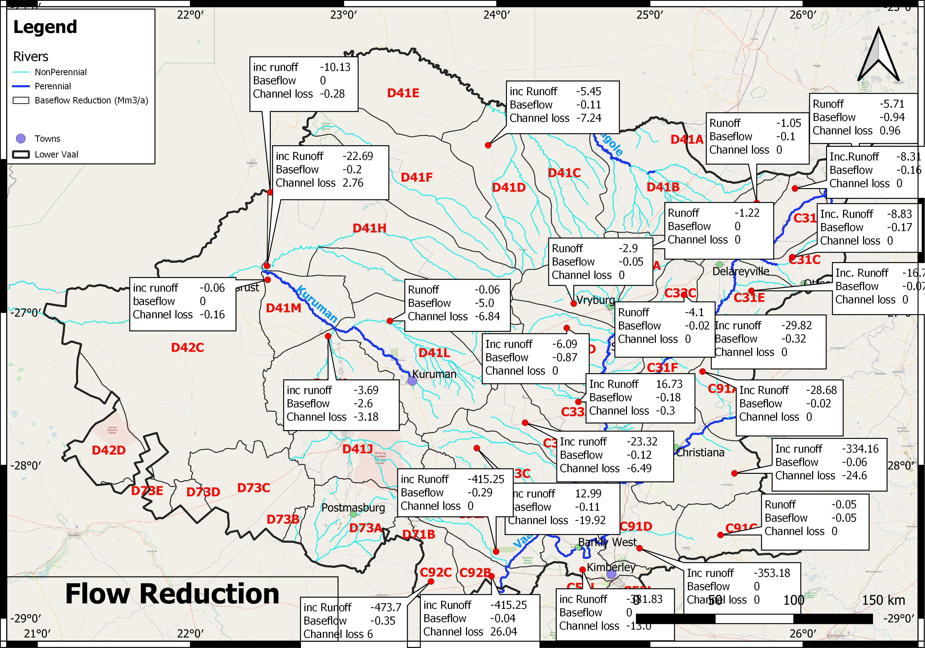
Lower Vaal Surface- groundwater interactions
FLOW REDUCTION

Slide 37
Lower Vaal Surface- groundwater interactions
CONCLUSIONS
Entire catchment generates 805.09 Mm³/a of recharge
109.06 Mm³/a emerges as baseflow.
105.39 Mm³/a of the baseflow is from dolomites.
Channel losses are 223.57 Mm³/a, of which 96.4 Mm³/a are in the Vaal, consisting largely of releases from the Bloemhof dam.
The remaining 127.17 Mm³/a are channel losses of the baseflow generated largely from dolomites.
Nett runoff from Lower Vaal is 87.76 Mm³/a.
Flow Reduction 474.54 Mm³/a. Baseflow has been reduced by 12 Mm³/a

Slide 38
Lower Vaal Surface- groundwater interactions
MAIN REPORT
Summary of findings
Study area description
Background and status quo: existing hydrology, Reserve, water supply infrastructure, water use, monitoring, groundwater resources
Hydrocensus: water use by schemes, registered water use, Schedule 1 water use
Water Resource Assessment: Rainfall, Observed flows, Simulated flows, aquifer storage, GW Exploitation Potential, Stress index and Class

Slide 39
Lower Vaal Surface- groundwater interactions
MAIN REPORT
Modelling of Recharge and Baseflow: Calibrations, MAR, Recharge, baseflow, channel losses
Interactions: natural and present day surface and groundwater, impacts
Water Quality: surface and groundwater
Protection zones: quality and quantity, water supply boreholes, aquifer vulnerability, baseflow vulnerability, groundwater stress vs water levels

Slide 40
Lower Vaal Surface- groundwater interactions
MAIN REPORT CONCLUSIONS
Total lawful use is estimated at 1068 Mm³/a, of which 1040 Mm³/a is registered on WARMS . Total water use for water supply equates to 121 l/c/d Schedule 1 water use is 27.8 Mm³/a
Vaalharts Water is the largest water user: 349 Mm³/a is for irrigation and 13.328 allocated to industry. Actual use from Vaalharts records differs from the registered allocations. Indicates only 26% of the water is utilised
Total water use for water supply is 94.798 Mm³/a, of which 48.179 is from surface water. Average per capita consumption is 145 l/c/d. Some abstraction may been missed for Greater Taung, Tswaing and Ratlou.
Total surface water use is 773.608 Mm³/a. Registered surface water use for water supply is 33.5 Mm³a, lower than the 48 Mm³/a estimated. However, the Vaal-Gamagara use is registered as Industrial rather than water supply. This registration is for 13.7 Mm³/a, significantly less than the actual use of 25 Mm³/a.
Registered groundwater use 266.28 Mm³/a. 69% of this use is for irrigation.

Slide 41
Lower Vaal Surface- groundwater interactions
MAIN REPORT CONCLUSIONS
A comparison of CHIRPS and Pitman rainfall data shows that the CHIRPS data do provide a good extension to the observed Pitman model rainfall record.
A significant problem with recharge estimation in isolation from surface water investigation is the potential for estimating large volumes of recharge whose fate is not accounted for, or possibly insufficient recharge to meet observed baseflow and spring discharge.
Average discharges from dolomitic areas are affected by the non-stationarity of flow records due to declining discharge with increasing abstraction. This makes estimating recharge only from spring flows problematic
Simulated recharge is significantly higher than GRAII in dolomites, and significantly lower in non dolomitic sub-areas

Slide 42
Lower Vaal Surface- groundwater interactions
MAIN REPORT RECOMMENDATIONS
Since Vaalharts Water is the largest water user, the discrepancy between Canal releases and Vaalharts Water records needs to be addressed to quantify actual use.
The licenced water use for Vaal-Gamagara needs to be reallocated and updated since they are a large water user.
The Reserve for the Lower Vaal needs to be updated (when it becomes possible) in light of the calibrated recharge and baseflow volumes derived and data on existing use.
The use of CHIRPS rainfall for monthly data is a useful tool to patch and extend rainfall records, particularly given the declining number of rainfall records. It also provides areal rainfall rather than point data, not always located in the most representative locations. The use of CHIRPS requires comparisons to SAWS data not just in terms of annual rainfall, but monthly distribution and standard deviation.

Slide 43
Lower Vaal Surface- groundwater interactions
MAIN REPORT RECOMMENDATIONS
Observed flow records cannot be used for baseflow separations to estimate recharge due to non-stationarity and declining/increasing discharge where abstraction or point source discharges impact the hydrograph
A significant problem with recharge estimation in isolation from surface water investigation is the potential for estimating large volumes of recharge whose fate is not accounted for, or possibly insufficient recharge to meet observed baseflow and spring discharge. Such water balance discrepancies should be investigated using integrated surface-subsurface methods before calculating the Reserve.
Endoreic areas must be utilised in simulations because the volumes of recharge and baseflow generated from endoreic areas is of significance to the water balance.

Slide 44
Lower Vaal Surface- groundwater interactions
MAIN REPORT RECOMMENDATIONS
Quat | Protection Required
 | Groundwater Quality | Groundwater Quantity |  | Baseflow Protection
 |  | Water level | Stress Index
C31A | High aquifer vulnerability to contamination | Water levels declining. Groundwater may be over utilised and caution required before further allocations. Some use may be undocumented | 0.8 | Abstraction can have a significant impact on baseflow and abstraction near a river or eye needs to be restricted within 1 km of an eye
C31B | Very high aquifer vulnerability to contamination | Water levels declining. Groundwater may be over utilised and caution required before further allocations. | 0.98
C31C | No intervention required
C31D | Very high aquifer vulnerability to contamination | Water levels declining. Groundwater may be over utilised and caution required before further allocations. Groundwater use verified. Some use may be undocumented | 0.3
C31E | No intervention required
C31F |  | High stress but no water level data. Monitoring required | 1

Slide 45
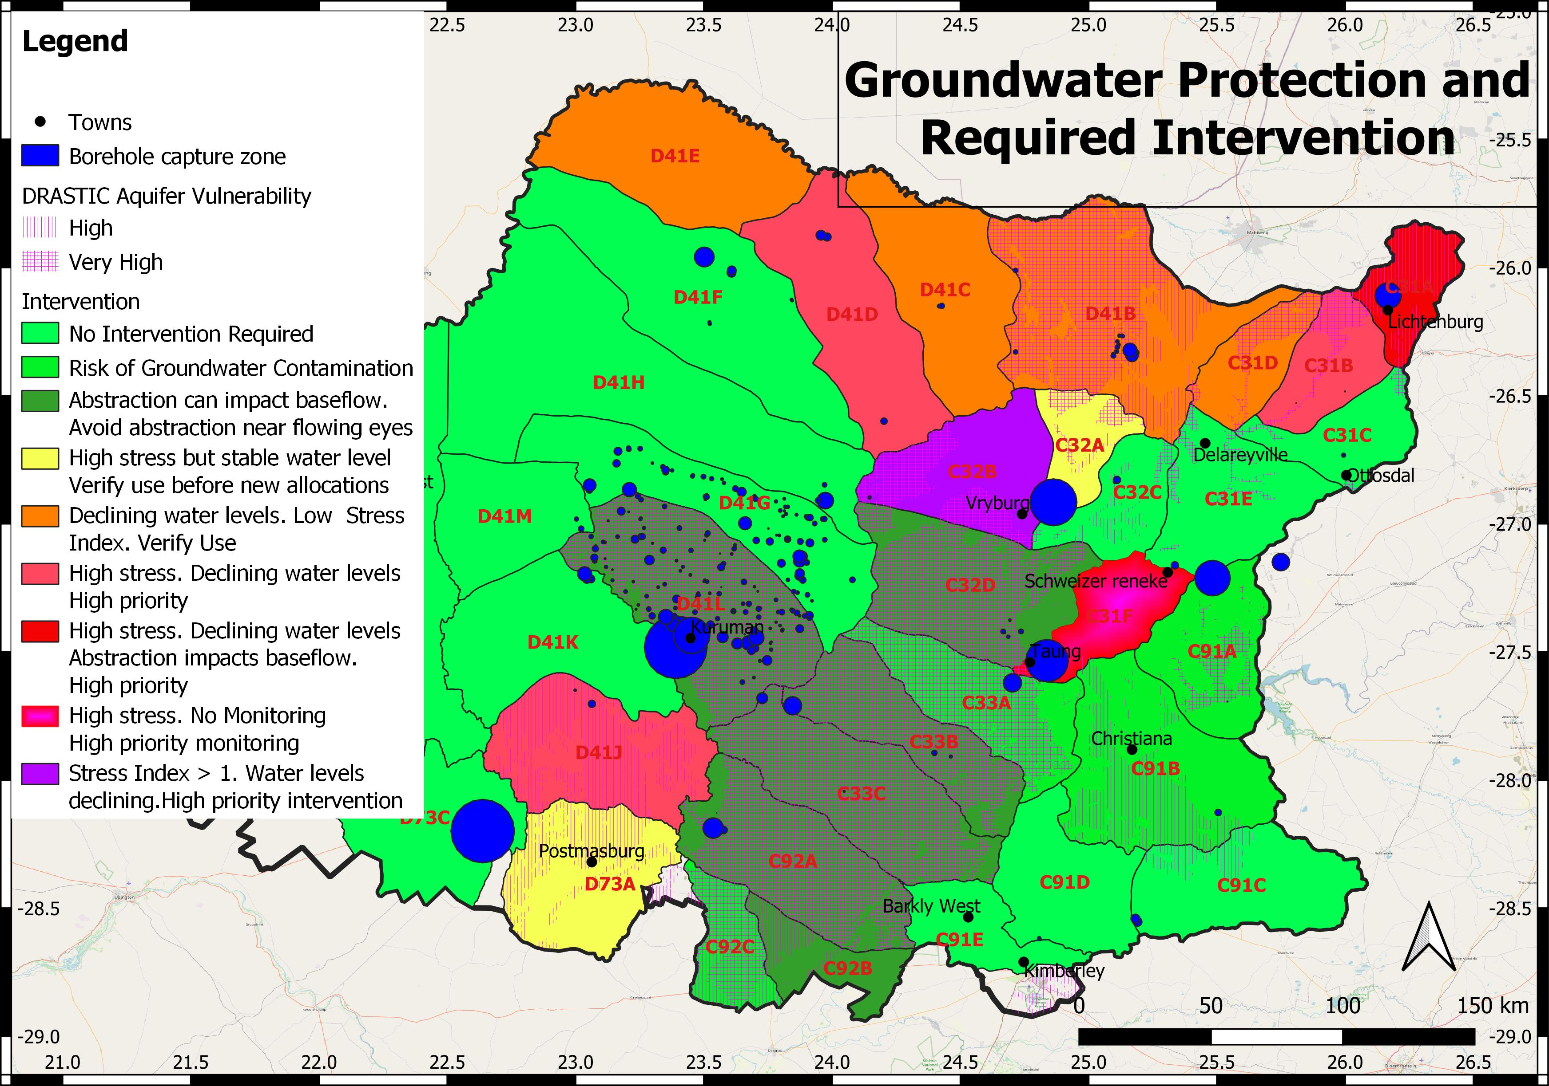
MAIN REPORT RECOMMENDATIONS

Slide 46
Lower Vaal Surface- groundwater interactions
OUTSTANDING
External reviewer report : Rodger Parsons appointed. Oct 23
Summary of capacity building ( to be in Closure out report
Close Out report

Slide 47
Questions and Clarification

